Slide 1

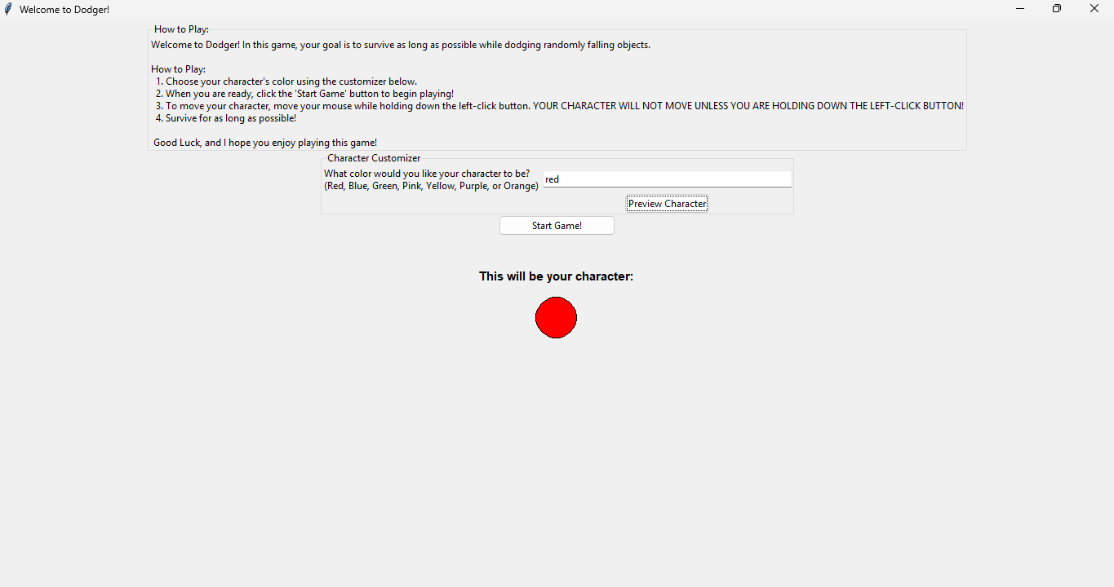
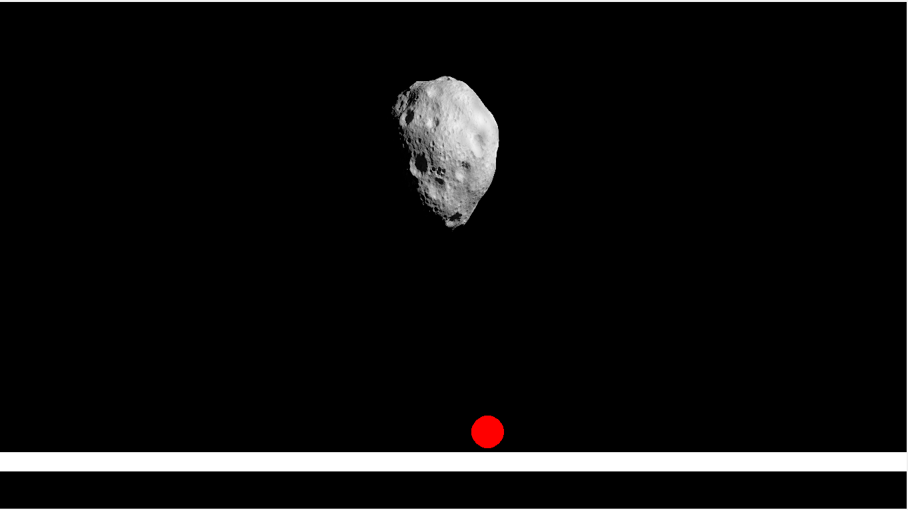
Avoid The falling Meteor
Diego Puga
This game is a very calm and easy to learn. You must avoid the upcoming meteor and get the highest score.

